Slide 1
New Hire Orientation
Human Capital Office
Payroll and Personnel Systems
Notes:
Welcome to the New Hire Orientation presented by HR Shared Services, Payroll, Benefits, and Personnel Systems.
In today’s presentation, you will be provided with a lot of information in a short period of time, so please pay close attention and write down any questions you may have.

Slide 2
Resources 1
On-line access via the intranet with the
IRS Source Website
IRS Service Central, the online self-service ticketing tool for problems with computers, phones, workspace and other support issues
ERC Chatbot with Live Agent Chat
Online training, travel guidance, and NFC Employee Personal Page among many others
Reference sites such as the Internal Revenue Manual (IRM), Westlaw, and Lexis/Nexis
Telephone access at 1-866-743-5748 Option 1, then Option 3.
Notes:
When logging into your computer, the Intranet page that should come up is IRS Source. You will find numerous programs on this page, as well as, some specific to your Business Unit.
IRS Service Central is an online self-service ticketing tool only accessible through the intranet. You use this tool for creating tickets for items such as phones, computers, workspace, security, etc. We also have the ERC Chatbot with a Live Agent. We encourage you to open IRS Service Central ticket or use the ERC Chatbot, as opposed to calling the Customer Service Line at the Employee Resource Center (ERC), due to excessive wait times. IRS Source also has travel guidance, online training, reference sites, the Employee Personal Page (EPP) and many others. If you cannot find what you need through these sources you should contact the Customer Service Line at ERC at 866-743-5748 option 1, option 3, then listen to the prompts for the correct area.

Slide 3
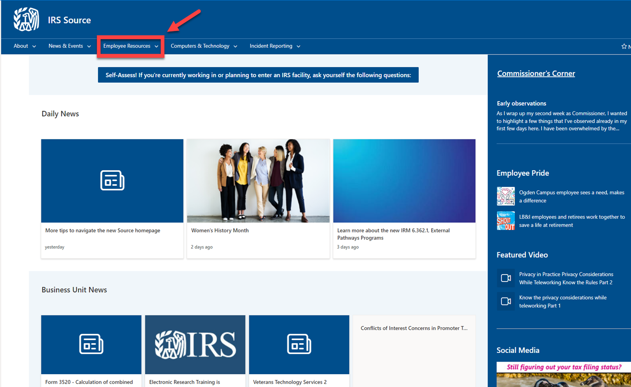
IRS Source Homepage
Notes:
When on the IRS Source Homepage, select Employee Resources to find a listing of items pertaining to Benefits, Pay, Retirement, and much more. Once you select Employee Resources, a drop down menu will appear.

Slide 4
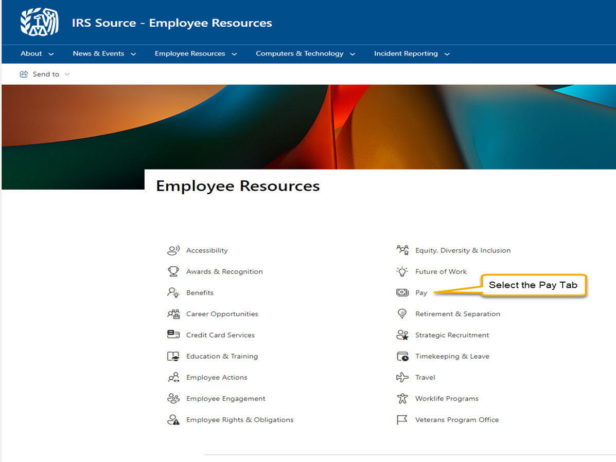
Locating Information
Notes:
One of the most important, if not the most important benefit, as an IRS employee is our pay. From the menu, select Pay, and another screen will appear.

Slide 5
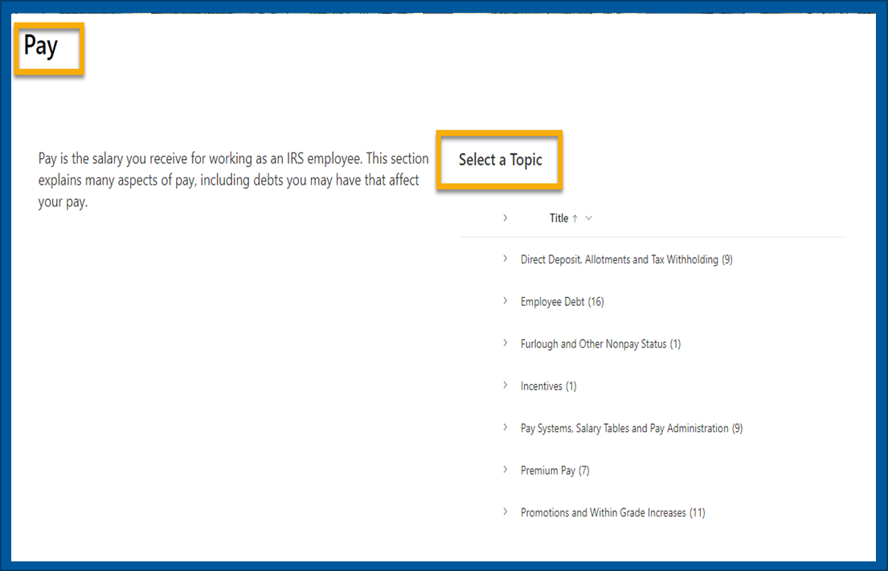
Identifying a Topic
When you select a specific tab, a list of topics within that subject will appear.
Notes:
Under the Pay tab, there are additional topics like: Combined Federal Campaign (CFC). This campaign is held once a year and your area will have numerous announcements about it throughout the campaign. You also will see options for the Furlough/Non-pay Status or Tax Withholding, just to name a few. Performance Awards are based on your annual performance and manager approval. Furlough/Non-Pay Status can be discussed more with your manager. Employee Debt can occur as a result of non-pay status, salary overpayments, and other reasons.

Slide 6
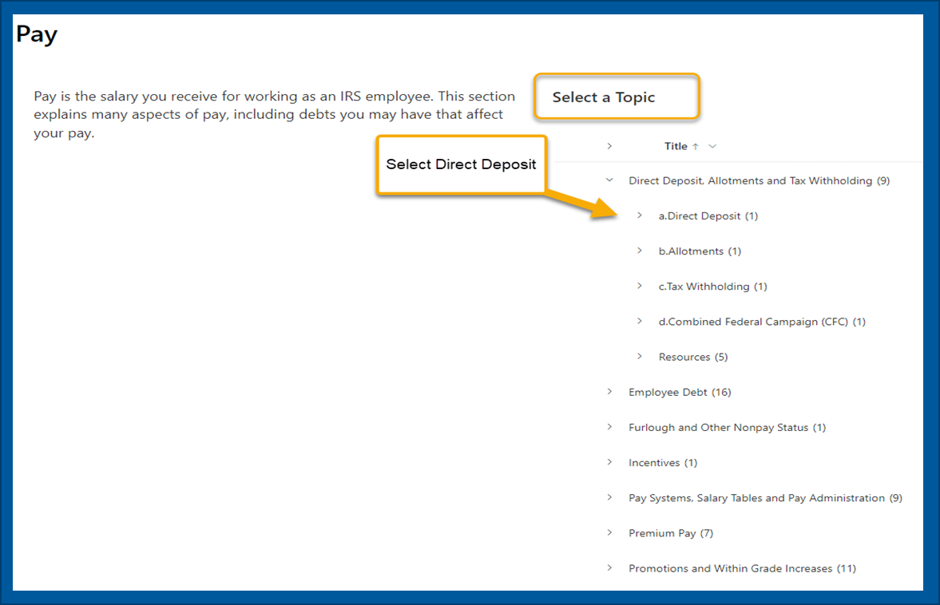
Narrowing Topic Choices 1
You can continue to research the topics as needed
Notes:
Under Direct Deposit, Allotments and Tax Withholding, there are narrowed down topics. We will select Direct Deposit to be routed to a more detailed description of this tab.

Slide 7
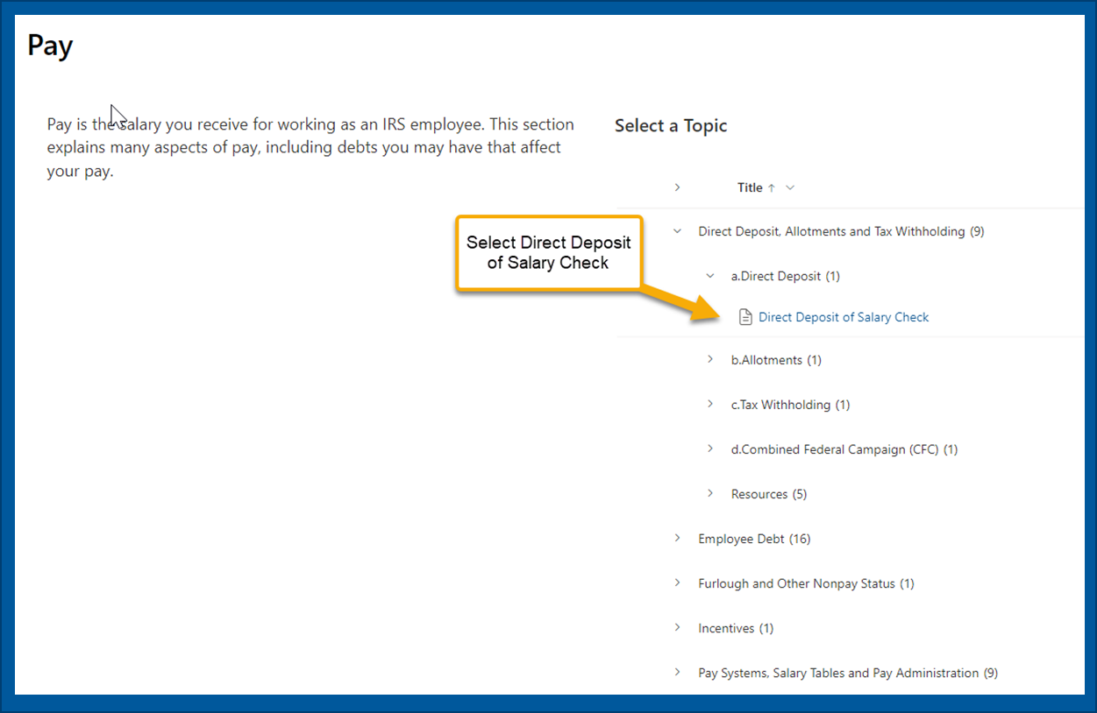
Continue to Narrow Topic Choices
Notes:
Select Direct Deposit of Salary Check.

Slide 8
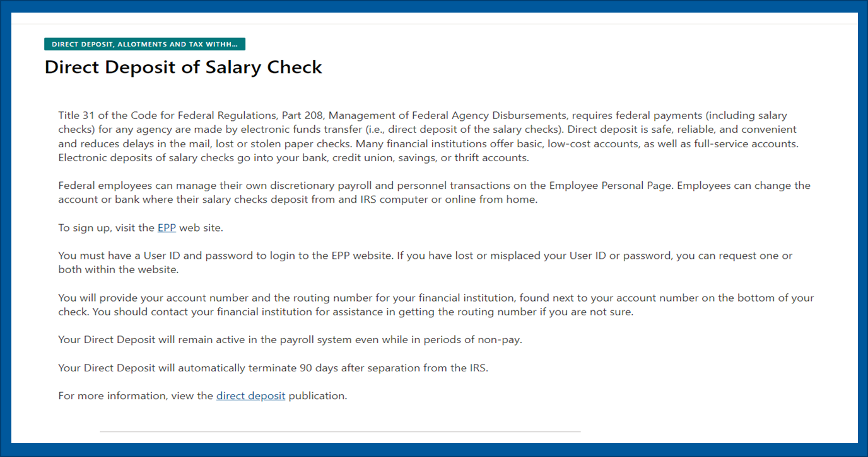
Locating the Answer
In this example, you will find specific information on Direct Deposit of Salary Checks.
Notes:
Under Title 31 of the Code of Federal Regulations, Part 208, Management of Federal Agency Disbursements, requires federal payments, including salary checks, for any agency, be made via electronic funds transfer. You can only have one direct deposit account for your payroll check; however, you can set up allotments for funds to be distributed. You likely provided your direct deposit information through the onboarding process; however, if you are unsure, or you didn’t provide it during the onboarding process, contact the Ogden Payroll Center through the Customer Assistance Line at ERC. Once you receive your first paycheck, you will be able to log into the Employee Personal Page to make any changes to your Direct Deposit. We will discuss the Employee Personal Page later in this presentation.

Slide 9
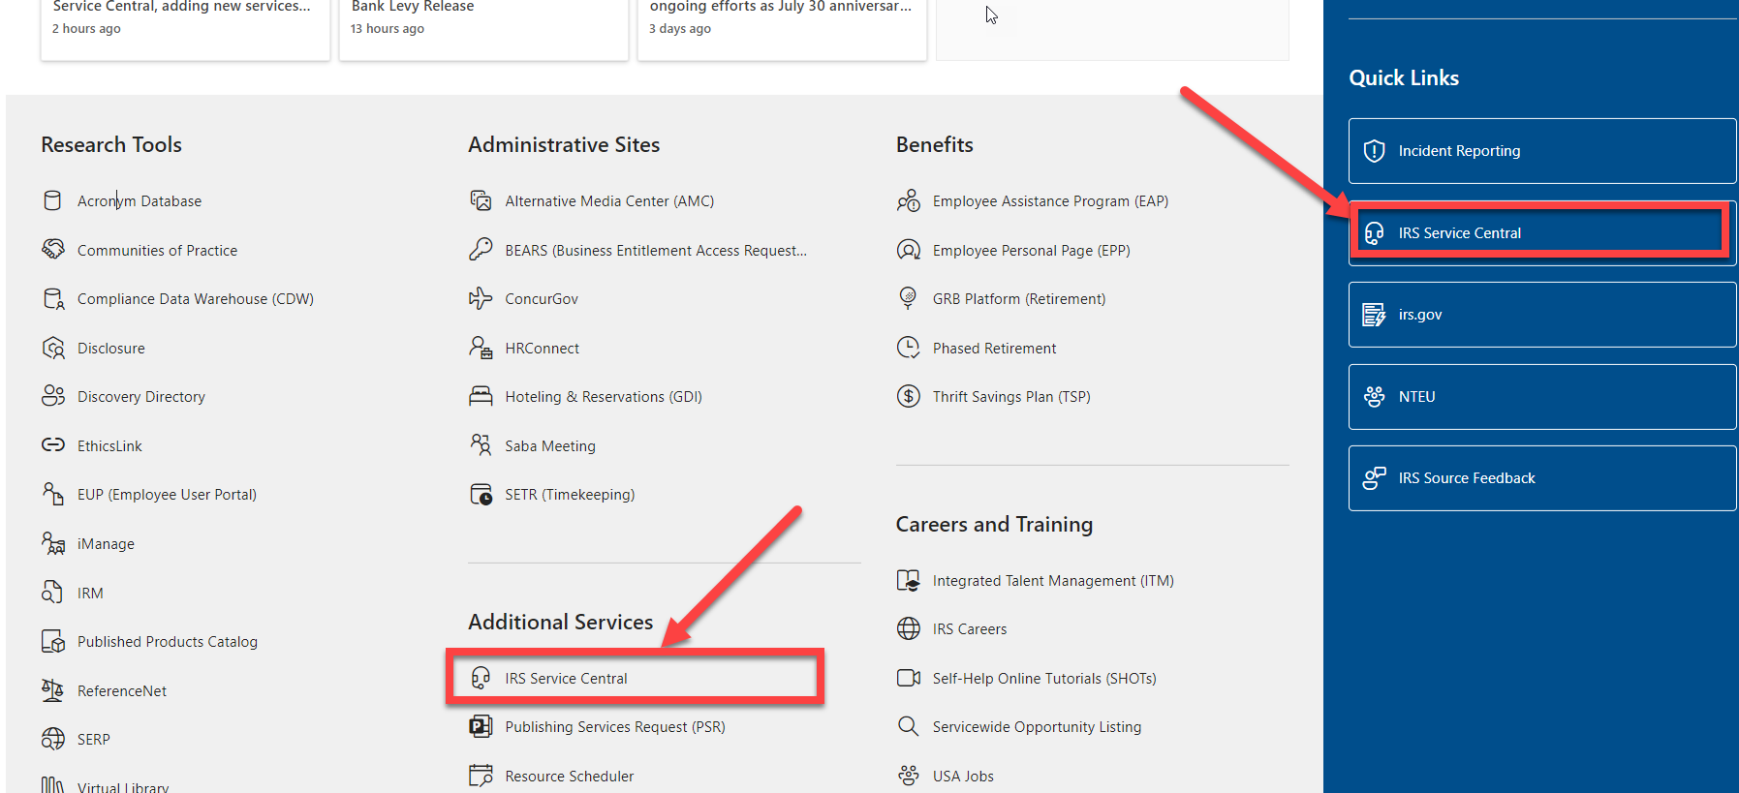
Links 1
Notes:
As stated earlier, there are many links to many systems on IRS Source. Another one that is used often, and was briefly mentioned earlier, is IRS Service Central . You can use this tool 24/7 from any IRS computer/intranet but it can not be accessed from a home computer.

Slide 10
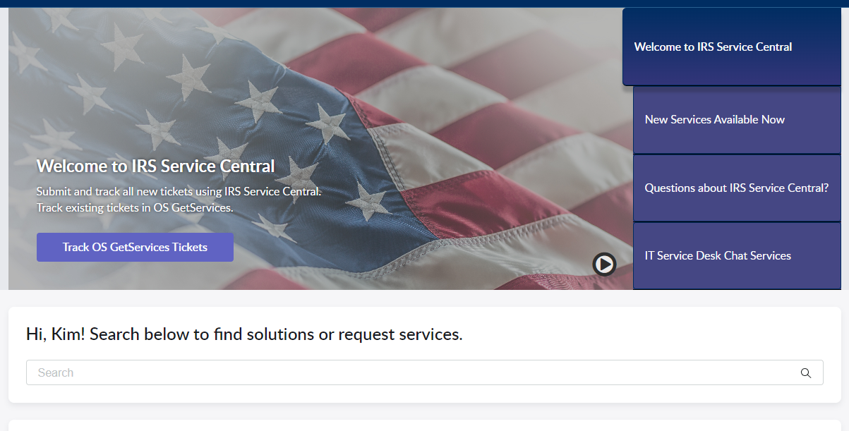
Example: IRS Service Central
Use IRS Service Central to submit tickets for services and repairs.
Notes:
Once in IRS Service Central , you can utilize the search key,

Slide 11
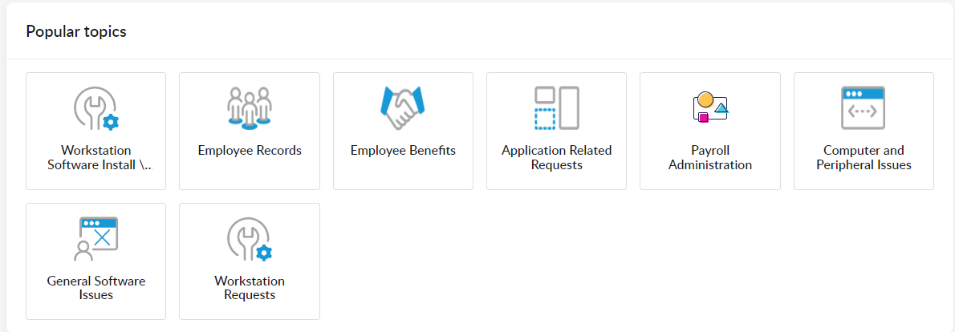
IRS Service Central
Notes:
You can scroll down to Popular Topics and select the topic that fits your needs.

Slide 12
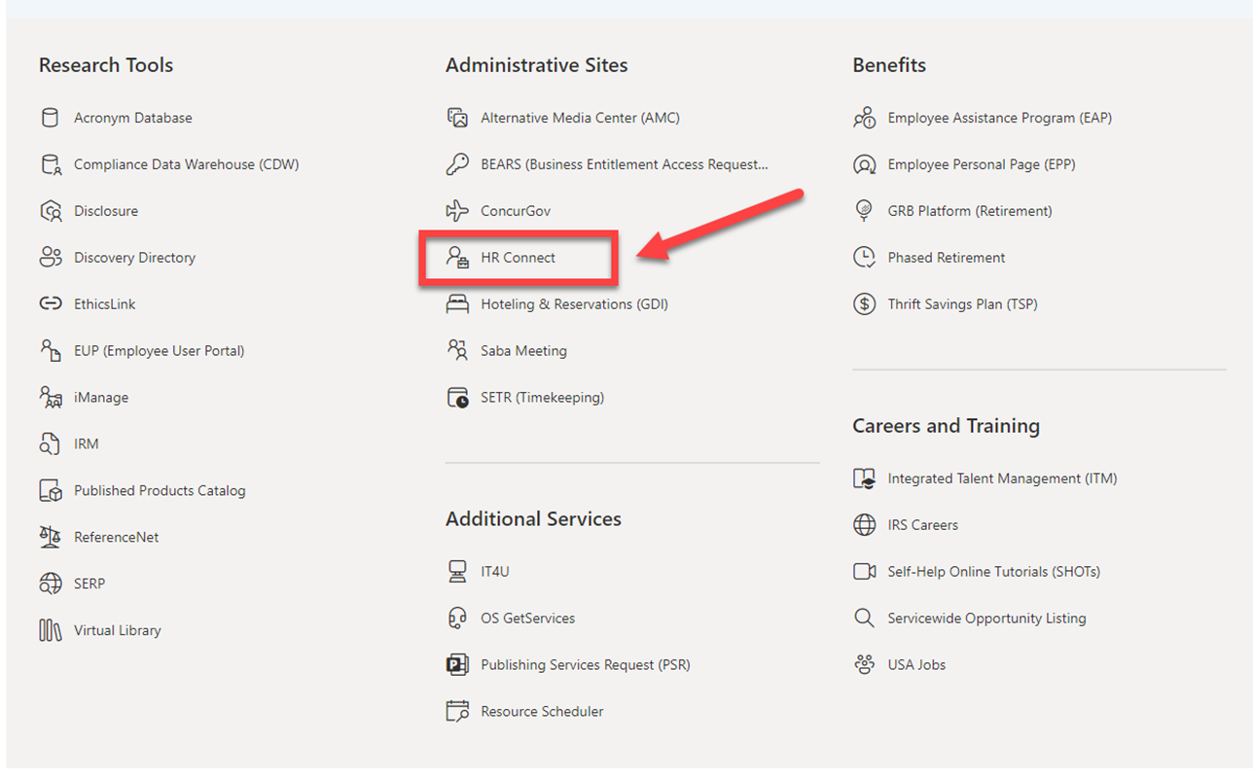
Links 2
Notes:
Another useful link available for your use, on the IRS Source page, is HR Connect. This is a tool used for updating your name, and/or address, viewing performance award/bonus information, as well as, where your evaluations are housed for 5 years. Your manager will be able to help you gain access to the HR Connect site, as well as log in. If they can not, you can contact the Employee Resource Center Customer Assistance Line at 866-743-5748 Option 1 and Option 1 again. If you did not catch that the number is 866-743-5748 Option 1, Option 1.

Slide 13
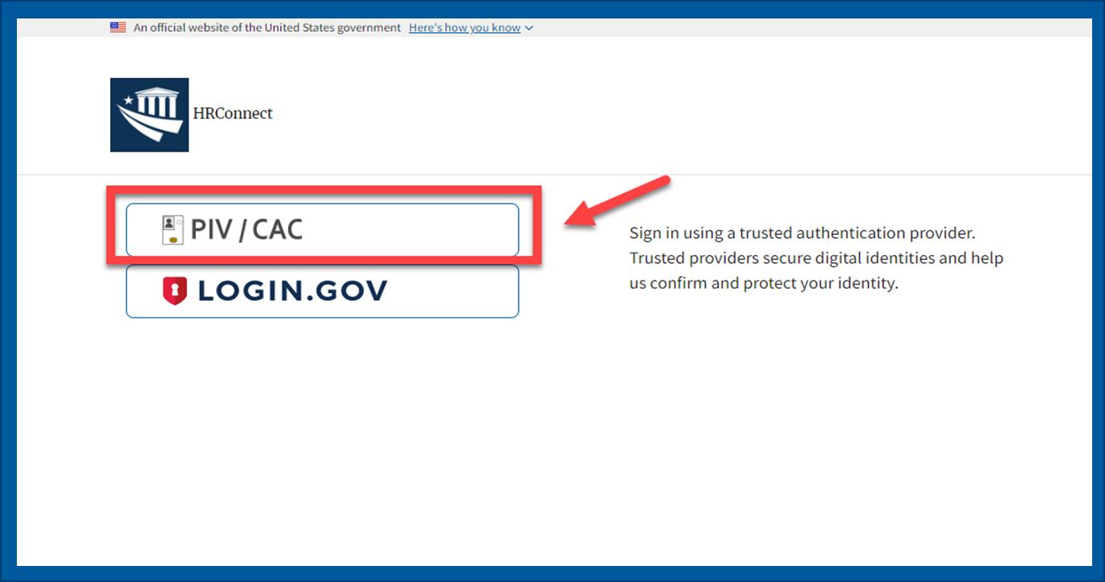
Logging into HRConnect 1
Notes:
Select the PIV/CAC option, you then will be prompted to input the password of your PIV Card. If you are still waiting to receive your PIV card, then you can gain temporary access by registering through Login.gov.
Please clear your cache if you are having issues signing in with your PIV. Clear Cache in MS EDGE
Replace any saved favorites/bookmarks with this URL:
https://hrconnect.treasury.gov/
Close all Edge browser windows
It is important that you close all Edge windows first.
Navigate to the application's login page
Click on PIV/CAC

Slide 14
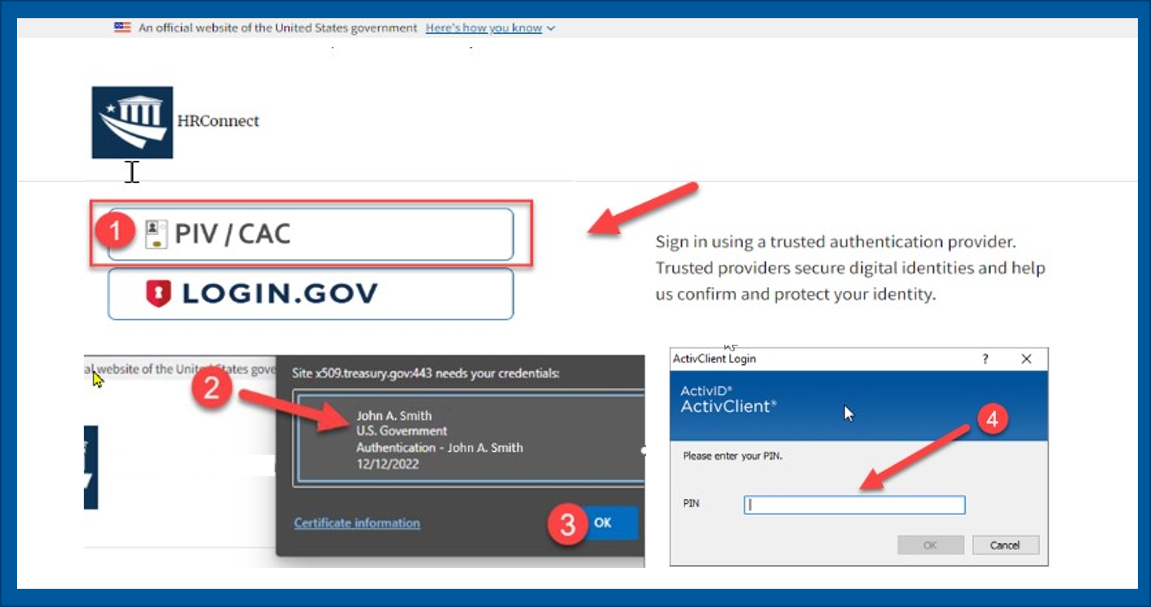
Logging into HRConnect 2
Notes:
Click the certificate (Red Circle #2); this step is necessary because, by default, Edge does NOT automatically select the user's PIV certificate. Ensure the Certificate is selected (Blue line around the certificate that is being used)
Click "OK"
Enter your PIN when prompted
User will be signed into HRConnect.

Slide 15
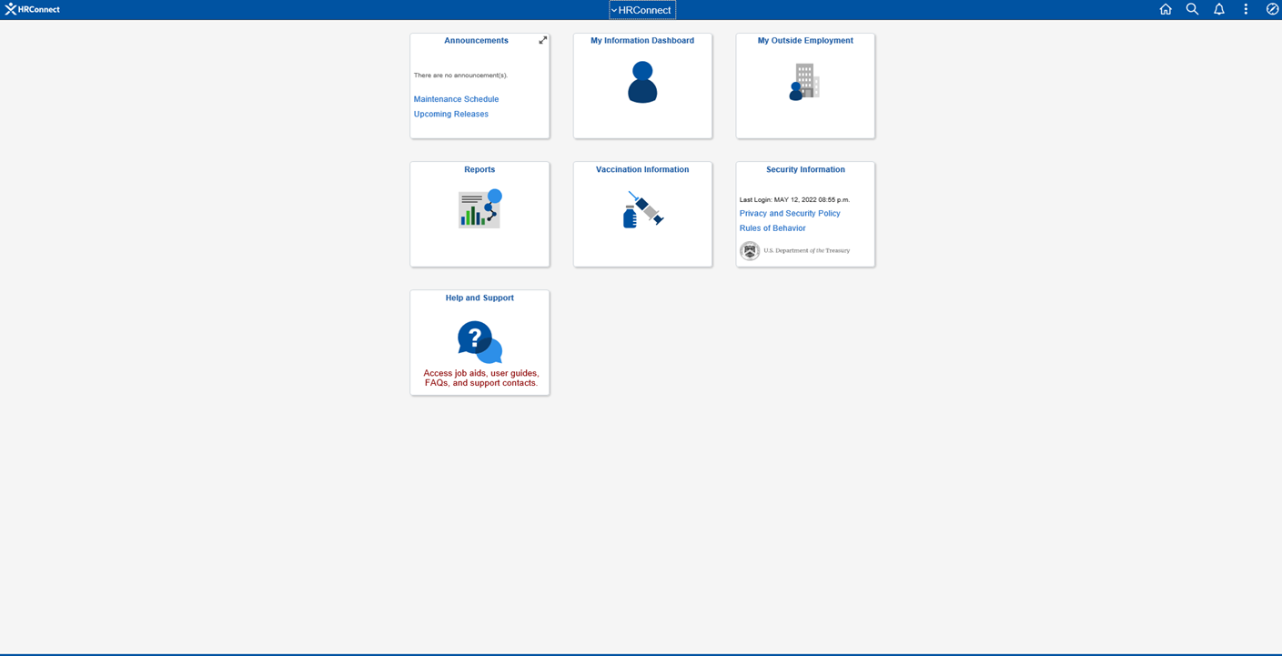
Information on HRConnect 1
Use HR Connect to keep your personal and emergency contact information current.
Notes:
Once logged in, you will go to the My Information tab.

Slide 16
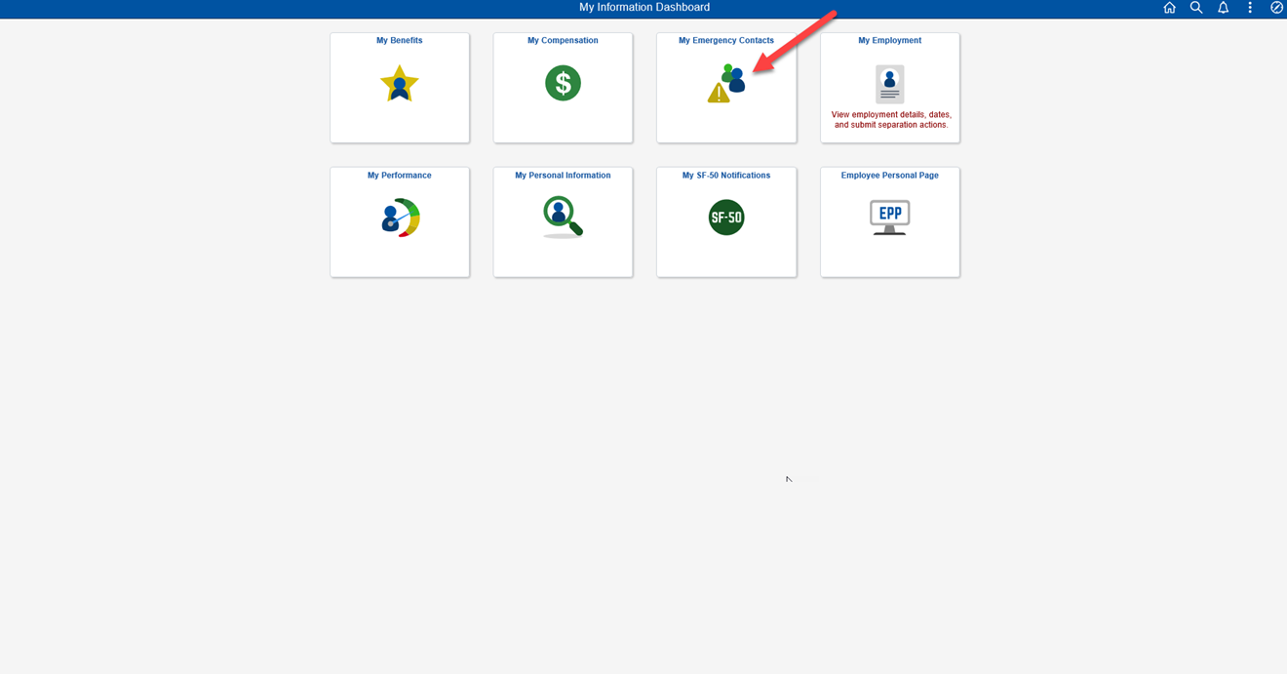
Information on HRConnect 2
Use HR Connect to keep your personal and emergency contact information current.
Notes:
Here you need to add your emergency contact information as soon as possible. This is how your management team would contact you or someone you identify in case of an emergency at work.

Slide 17
Human Capital Office
Payroll and Benefits
Notes:
These next slides are very important, so pay very close attention.

Slide 18
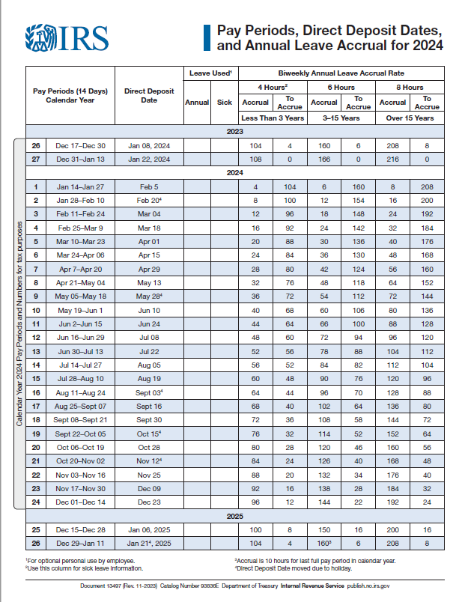
Pay Day
Notes:
Direct Deposit payments are the Monday following the completion of the Payroll process, or Tuesday for those pay periods when Monday is an official Federal holiday. This early posting to personal bank accounts is a courtesy by some, but NOT all financial institutions, as they are not obligated to post funds earlier than the actual payment date. The official pay days are every other Thursday. https://core.publish.no.irs.gov/docs/pdf/d13497--2023-02-00.pdf

Slide 19
Annual Leave / Sick Leave
As a new employee, your annual and sick leave are accrued at 4 hours per pay period. (Exception: If you have previous creditable civilian or military service or are part time.)
If you are transferring from another federal agency to the Internal Revenue Service, you may submit a copy of your last Statement of Earnings and Leave, to expedite the transfer of your leave balances and insurance:
      Enter a service request ticket in IRS Service Central.
      Search and select “Leave Category Inquiry”
      Select “Change” in Request type field
      Type the full explanation to request to obtain prior leave balances from prior service
      Add attachments (Only final SELs will be considered for leave transfer if the Agency has not received the SF-1150 from your prior agency)
      Submit
Notes:
New employees accrue annual and sick leave at a rate of 4 hours per pay period. If you have prior creditable civilian or military service, or you are part time, your annual leave accrual may be different.
If you are transferring from another agency, you can submit your last statement of earnings and leave from your prior agency to expedite the transfer of your leave and health insurance. Expedited service can still take several pay periods, so please be patient.
If you are transferring from another Federal Agency
Enter a service request ticket in IRS Service Central.
Search and select “Leave Category Inquiry”
Enter the requested information to open your ticket.
Select “Change” in Request type field
Type the full explanation of request to obtain prior leave balances from prior service (prior agency information and payroll POC, attachments sent, last day at agency)
Add Attachments
Note: regarding attachments: Only final SELs will be considered for leave transfer if the Agency has not yet received the SF-1150 from your prior agency.
Submit

Slide 20
Paid Parental Leave
The President signed the National Defense Authorization Act (NDAA) for Fiscal Year 2020 into law on December 20, 2019. The NDAA provides 12 weeks (up to 480 hours) of paid parental leave (PPL) for the birth, adoption or foster care placement of a child occurring October 1, 2020, or later, for employees covered by the Family and Medical Leave Act (FMLA), regardless of gender.
Employees are eligible for PPL if they have 12 months of covered, consecutive or non-consecutive federal service, if the federal service was covered under the Title 5 FMLA provision.
Timekeeping - Paid Parental Leave ( PPL) (irs.gov)
Notes:
The National Defense Authorization Act (NDAA) provides 12 weeks (480 hours) of Paid Parental Leave for the birth, adoption or foster care placement of a child occurring October 1, 2020, or later, for employees covered by the Family and Medical Leave Act (FMLA) regardless of gender. Employees are eligible for PPL if they have 12 months of covered, consecutive or non-consecutive federal service, if the federal service was covered under the Title 5 FMLA provision.

Slide 21
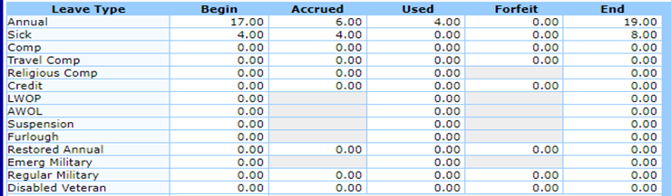
Wounded Warrior Federal Leave Act
The Wounded Warrior Federal Leave Act of 2015 provides a one-time entitlement for newly hired federal employees, hired on or after Nov 5, 2016, who are veterans with a qualifying service-connected disability rated at 30% or greater, to undergo medical treatment for such disability for which sick leave could regularly be used. Disabled Veteran Leave may not exceed 104 hours for a full-time employee and will be prorated for employees with part-time tours of duty (TOD).
This leave is automatically credited for veterans who have been properly coded as having a service-connected disability rating of 30% or greater.
Review your SETR leave balances to verify you have been properly credited for Disabled Veteran Leave.
For eligibility criteria and policy guidance, refer to:
Disabled Veteran Leave (opm.gov)
Notes:
This leave is automatically credited during the onboarding process if the veteran provided the Veterans Benefits Administration (VBA) certification of the qualifying service-connected disability rated at 30% or greater. If the Disabled Veteran Leave was not credited, the employee must submit an IR Works ticket along with the VBA certification documentation.
* If the employee has not been properly credited for Disabled Veteran Leave, they must submit a ticket through IRWorks on the IRS Service Central Page along with the supporting documentation (VA Benefits Letter).

Slide 22
Statements of Earnings & Leave
(Pay Stub)
Review your Statement of Earnings & Leave (SEL) each pay day to ensure your pay, deductions and leave information is correct
Access your statement on the Employee Personal Page (EPP).
Notes:
It is a good practice, as well as your responsibility, to review your statement of earnings and leave after each pay date to ensure no errors were made during the input of your time by you, the timekeeper, management, etc. You want to ensure proper taxes are withheld, as it is your responsibility to be tax compliant. You can access this information through the Employee Personal Page (My EPP), which we will discuss later in this presentation. Your Statement of Earnings & Leave will be posted on your Employee Personal Page the Monday of payday.

Slide 23
Employee Personal Page (EPP)
All IRS employees are automatically signed up for My EPP when they are hired. EPP is a convenient “One-stop shop” that is available 24/7 from any computer with internet capabilities, which means you can access from Home or Work. EPP gives you the ability to review or change:
Earning and Leave Statements (Pay Stub)
W-2’s
Direct deposit information
Federal Healthcare insurance (FEHB) enrollment
Qualifying life event changes to your healthcare information
Health savings (FSA) allotments
Federal and State tax withholding allowances
Personal address information
Thrift Savings Plan and “catch-up” elections
Annual Personal Benefits Statements
Notes:
The Employee Personal Page (EPP) is a “One-stop shop” available 24/7 from any computer/smartphone/tablet with internet capabilities. You can access this information from home or work. You can review your statement of earnings and leave, W-2’s and annual Personal Benefits Statements. You can also review and change other deductions, such as FEHB enrollment (based on a Qualifying Life Event (QLE) or Open Season, Allotments, Federal and State tax withholdings and many others.

Slide 24
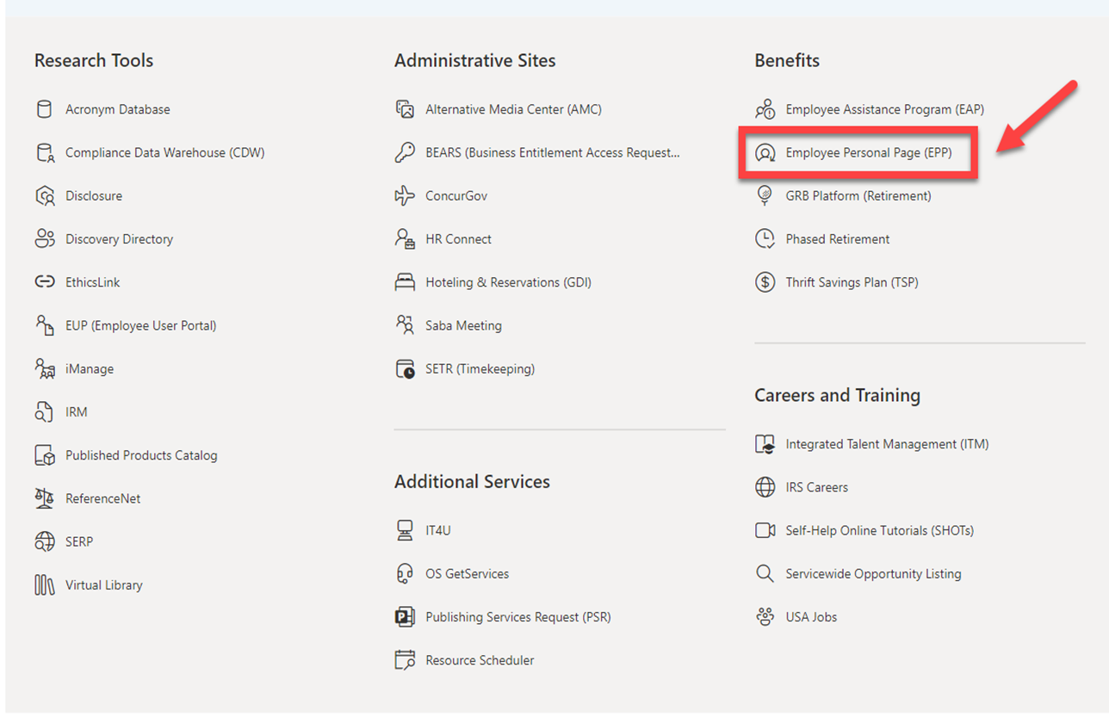
Accessing EPP from IRS Source
Notes:
To access the EPP from work, go to the IRS Source home page, scroll down to the Benefits banner and select Employee Personal Page.

Slide 25
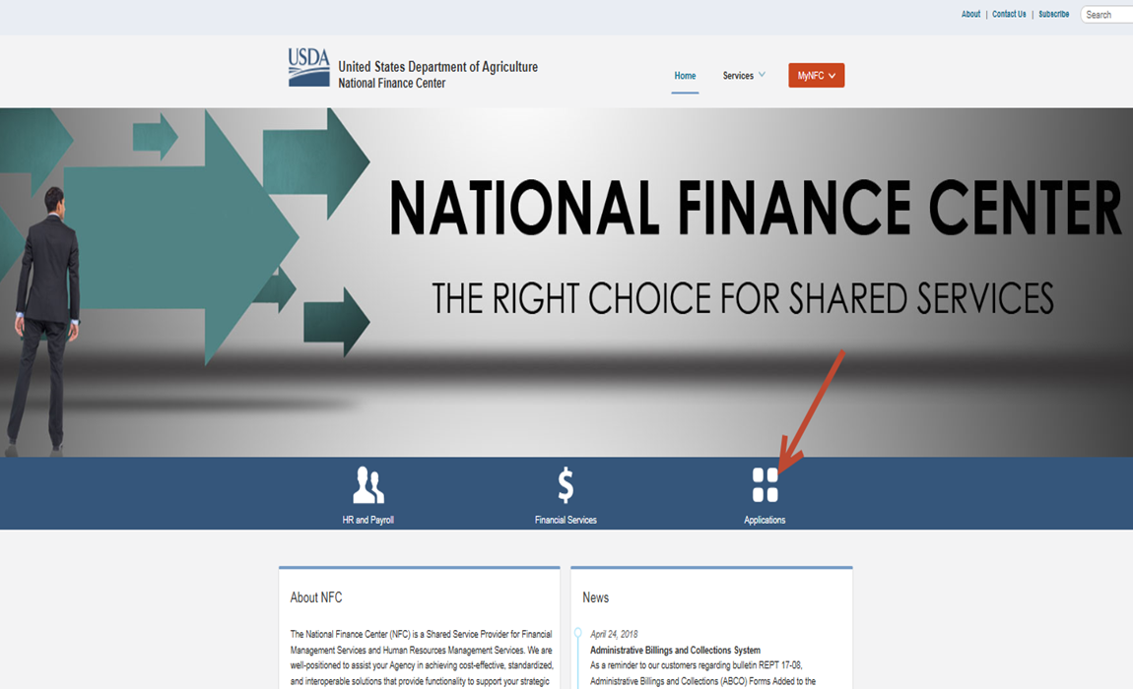
Accessing EPP from Home 1
To access My EPP from home, visit the National Finance Center’s home page on the internet by going to https://www.nfc.usda.gov.
Select “Applications”
Notes:
To access from home, go to https://www.nfc.usda.gov. Select Applications.

Slide 26
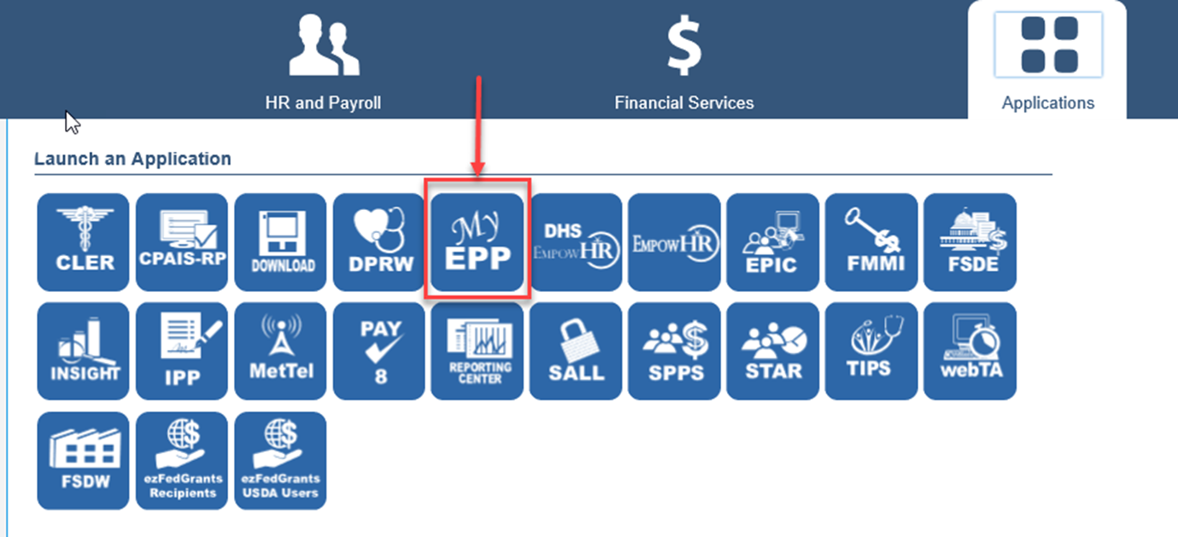
Accessing EPP from Home 2
From the drop-down menu select “My EPP”
Notes:
From the drop-down menu select My EPP

Slide 27
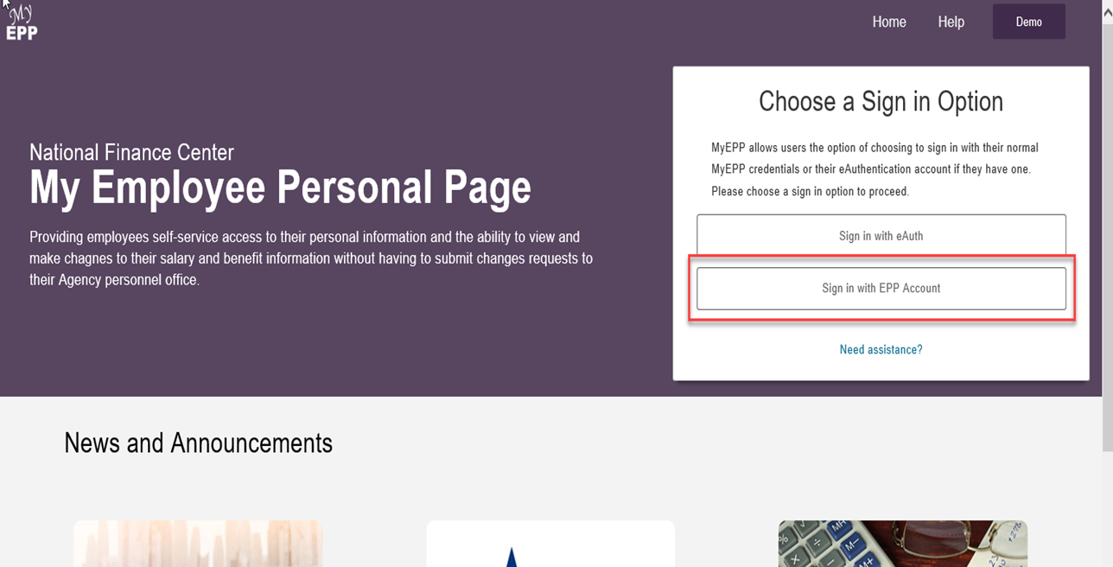
Accessing EPP 1
To continue the EPP Login Page select “I Agree”.
You will be directed to the EPP Login Page.
Notes:
From the Login page you will select: Sign in with EPP Account

Slide 28
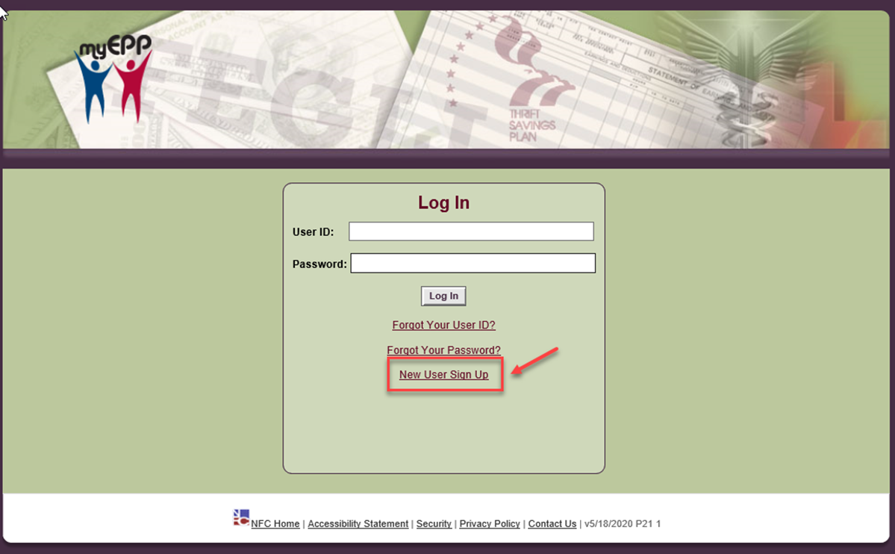
Accessing EPP 2
You will be directed to the EPP Login Page.
Here you will select, “New User Sign-Up”
Notes:
To gain access to the EPP, you must register. From the Login screen, you will select the New User Sign Up link

Slide 29
New Employee Accessing EPP for first time
EPP will not be available to you until you have completed and been paid for your first pay period with the agency.
If you have been issued an IRS Work Email
Select “New User Sign-Up”
Enter your Social Security Number (no dashes) and your date of birth (mm/dd/yyyy), select continue
Enter your IRS Work email address in both fields select “Sign-Up”
If you have NOT or will NOT be issued an IRS Work Email
Contact ERC at 866-743-5748 Options 1 and 1 again and request your SPO PIN.
From the EPP Login screen select “New User Sign-Up”
Enter your Social Security Number (no dashes) and your date of birth (mm/dd/yyyy), select continue
Select, “No Work Email Address”
Enter the SPO PIN given to you by Payroll, select continue
Enter your personal email address in both fields, select “Sign-Up”
In both cases, the temporary password will be emailed to the email address you entered. When you receive it, go to the EPP login page. Input your Social Security Number (no dashes) for your User ID and the temporary password in the password field.
Notes:
As a new employee, you won’t be able to access EPP until after you receive your first salary check. Once you have received your first check, you will follow the instructions on this page to register and gain access to the EPP.

Slide 30
Transfer Employee Accessing EPP
If you are a transfer employee that previously had an EPP account, you will need to:
      Contact the Employee Resource Center 866-743-5748 Option 1, then Option 1.
      Request that a Doc 444 be submitted to update your account with IRS information.
Notes:
If you are transferring from another agency where EPP was used, you need to contact Payroll and Benefits via the Customer Assistance Line, at 866-743-5748 options 1, then option 1. Inform the Payroll Representative you transferred from another agency who used EPP and you need a 444 document submitted to update your account with IRS information.

Slide 31
EPP Two-Step Authentication
EPP has a two-step authentication process to strengthen the security posture regarding employee’s information.
You will be asked to authenticate each time you log into EPP.
Notes:
As an added layer of security, EPP has a two-step authentication process you’ll be asked to complete at each login.

Slide 32
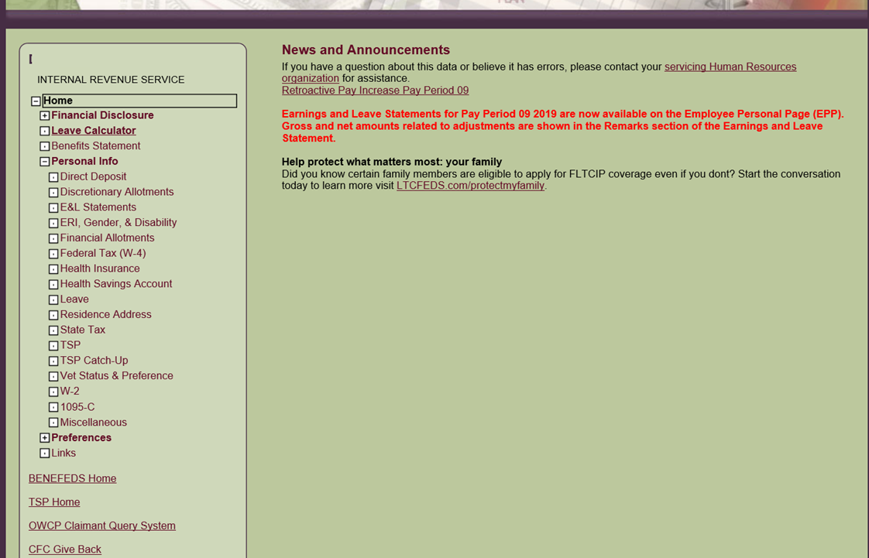
EPP Menu Home Page
When successfully logged into EPP, you’ll see a list of payroll topics. To make changes or view statements select a topic
Notes:
Once logged in, you will see a menu of options regarding your pay and benefits.

Slide 33
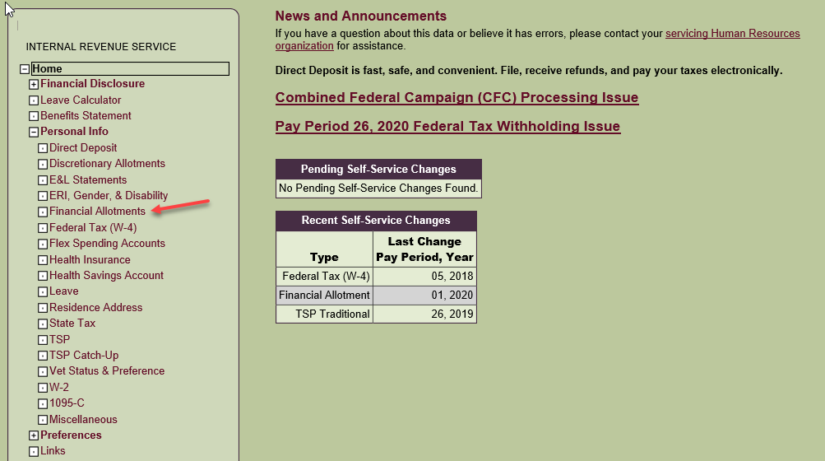
Making EPP Changes 1
To make a change, select any option from the menu
Notes:
To make a change, select an option from the menu. In this example, we are using the Financial Allotment.

Slide 34
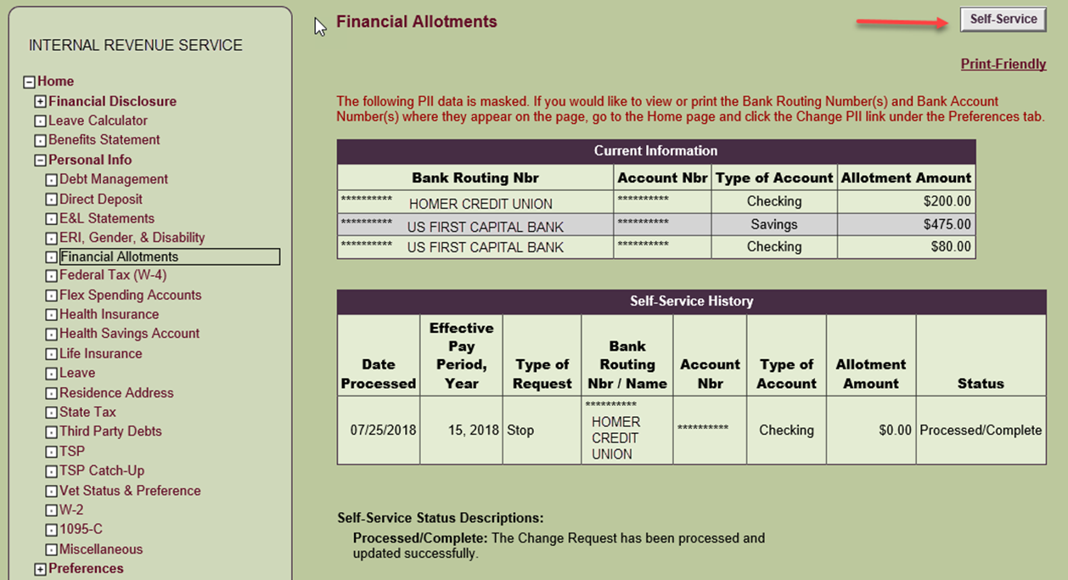
Making EPP Changes 2
Select the Self-Service tab, and follow the prompts on the upcoming screens
Notes:
Once the window for the option you’ve chosen opens, select the gray “Self Service” icon in the upper right corner, then complete your change. Make sure to select submit. You will receive a confirmation email once you submit your change.

Slide 35
Employee Self Help Tools
You will receive multiple passwords and/or Personal Identification Numbers (PIN) by email or mail. Each one is specific to a particular system that enables you to perform payroll or personnel related transactions
DO NOT LOSE THEM!
Notes:
As a new employee, you will receive a lot of information in a short amount of time. You will also receive numerous Personal Identification Numbers (PIN) via email or personal mail for different systems. Each PIN is unique to an individual system, so do not lose them.

Slide 36
Seasonal Employees – Full or Part Time
Health and Life Insurance
Federal Employee Health Benefit (FEHB) Eligibility: Seasonal employees who work six months or more during the current season/year and are expected to work six months or more during each subsequent year can be certified for both Health (FEHB) and Life (FEGLI) insurance. Full-time seasonal employees will receive the same government contribution as full-time permanent employees. Part-Time seasonal employees are covered under the Part-time Career Act and will have their FEHB premium prorated based on the number of hours they work. (Note: employees may only be certified for FEHB once per appointment).
Federal Employee Group Life Insurance (FEGLI) Eligibility: Generally, basic life insurance is automatic if you have a permanent appointment or convert to a permanent appointment, are a permanent, part-time employee, or are in a position with Federal retirement coverage, or are on a temporary appointment exceeding one year.
Notes:
Seasonal Employees are employees who work six months or more during the current season or year AND are expected to work six months or more during each subsequent year.
If this is you, you can be certified for both Health insurance and Life insurance.
Full-time seasonal employees receive the same government contribution for Federal Employees Health Benefits (FEHB) as full-time permanent employees.
Part-time seasonal employees are covered under the Part-time Career Act and will have their FEHB premium prorated based on the number of hours in their part time tour of duty.
Employees may only be certified for FEHB once per appointment. For Federal Employees Group Life Insurance (FEGLI); Basic life insurance is generally automatic if you have a career conditional appointment or convert to a career appointment, you are a permanent, part-time employee, you are in a position with Federal retirement coverage, or you are on a temporary appointment exceeding one year.

Slide 37
Health and Life Insurance
Forms SF-2809 for health insurance and SF-2817 for life insurance should be completed through the USA Staffing system.
You have up to 60 days to make an election and submit through the USA Staffing system. If possible, you should also upload your verification documentation for all eligible family members.
If you are unable to load your verification documents through USA Staffing you can email them to Ogden.Benefits.Section@irs.gov. You can fax to 855-816-9805 if email is currently unavailable to you.
Notes:
FEHB (SF-2809), and FEGLI (SF-2817), forms should be completed and submitted through the USA Staffing system. You have up to 60 days to make an election and submit through USA Staffing. Keep in mind the sooner you submit your forms, the sooner your insurance will be effective. If you are unable to provide your verification documents through USA Staffing, you can email them to Ogden.Benefits.Section@irs.gov. If email is not available to you, you can fax your documents to 855-816-9805. While you have up to 60 days so submit verification of eligible family members, please don’t wait and risk not having coverage for your family.

Slide 38
Federal Employee’s Health Benefits (FEHB) 1
Guaranteed coverage
No medical examination required
No restrictions for preexisting conditions
On average, the Government pays 75% of premiums
Pay premiums with pre-tax dollars
Continued coverage in retirement
Visit http://www.opm.gov/insure for more information. This includes brochures for participating carriers
Notes:
FEHB provides the following:
guaranteed coverage
no medical exam required
no restrictions for preexisting conditions
75% of the premium is paid by the government on average
you can pay premiums with pre-tax dollars
you can carry the coverage into retirement. There are stipulations on carrying into retirement, so make sure to listen for that information or contact your retirement specialist if this is of interest to you.

Slide 39
Furlough/Non-Pay / Leave Without Pay (LWOP) impact on FEHB Coverage
The first time you go into non-pay or have insufficient pay you will receive a future election letter regarding your FEHB coverage.
Make sure to review and respond to any, and all, IRS correspondence you receive so your benefits are not impacted.
If you do not respond appropriately to future correspondence, you risk your FEHB insurance being terminated once you have been in a non-pay status for 365 days. The 365 days does not need to be continuous but may be broken by periods of pay status.
If your coverage has been terminated, you can re-enroll within 60 days after returning to duty. Then you must be in a pay status at least part of each pay period for four consecutive months (9 pay periods) or your insurance will be terminated with the next period of non-pay status.
If you are in a pay status for at least four consecutive months, the clock restarts for the 365 days of permissible continuation of coverage.
Notes:
Furlough, Non-Pay, or Leave Without Pay (LWOP) can impact your health insurance, as it can cause you to owe a debt to the Agency.
When you go into non-pay status or insufficient pay you will receive an election letter for your FEHB coverage. This election letter asks you to choose whether to continue your health insurance coverage or to terminate, while in non-pay or insufficient pay status. If you choose to continue your coverage, you will remain covered, and the agency will pay your premiums while you are in the non-pay status, incurring a debt to the Agency. Once you return to pay status the premiums paid by the agency will be garnished from your pay until the debt is paid in full. If you choose to terminate coverage during non-pay, you will have an opportunity to re-enroll when you return to duty. If you are in a Non-Pay status for more that 365 days, your insurance will be terminated. The 365 days do not have to be continuous and may be broken into several periods of non-pay or furlough status. If your coverage has been terminated, you can re-enroll within 60 days after returning to duty. You must be in pay status for at least part of each pay period, for four consecutive months, or 9 pay periods, otherwise your insurance will be terminated with the next period of non-pay status. If you are in pay status for at least four consecutive months, the clock restarts the 365 days of permissible continuation of coverage. It is important you read and respond to ANYTHING you receive from IRS. If it is something you do not understand, call Payroll through the Customer Assistance Line for assistance.

Slide 40
Additional Health Care Benefits
    The Federal Employees Dental and Vision Program (FEDVIP) www.benefeds.com
Flexible Spending Account (FSA) www.fsafeds.com
Enroll within 60 days of EOD
  Enrollment is via the website and not associated with your health insurance enrollment (i.e., SF2809)
  Visit https://www.opm.gov/healthcare-insurance/healthcare for more information to help with your decisions
Notes:
There are additional benefits offered to you, as an IRS employee; however, these are not benefits Payroll assists with. These are separate from your FEHB coverage and you need to contact the providers, individually, for assistance. The additional benefits available are Federal Employees Dental and Vision Program (FEDVIP), and Flexible Spending Account (FSA). You have 60 days from your Enter on Duty (EOD) to enroll in any of these benefits. You can find more information regarding their programs on their websites or by going to the Office of Personnel Management website.

Slide 41
Supplemental Coverage Dental & Vision
Supplemental dental & vision coverage are available for additional premiums
Enrollment is done online at www.Benefeds.com
There are enrollment limitations for seasonal employee working less than 6 months.
Notes:
The Federal Employees Dental and Vision Program (FEDVIP) is supplemental to your FEHB plan and require additional premiums. The enrollment for vision and dental is done online at www.Benefeds.com. There are enrollment limitations for seasonal employees working less than 6 months. Remember, this benefit requires you to correspond or speak with a Benefeds representative for more information.

Slide 42
Federal Employee’s Group Life Insurance (FEGLI) 1
Guaranteed coverage
No medical examination required if elected when first eligible
Term Insurance – No Cash Value
Four parts to FEGLI
      Basic Life Insurance
      Option A, Standard
      Option B, Additional
      Option C, Family
FEGLI calculator can be found at https://www.opm.gov/retirement-services/calculators/fegli-calculator/
  Refer to https://www.opm.gov/healthcare-insurance/life-insurance/reference-materials/handbook.pdf for more information.
  You will receive more information regarding FEGLI in the next presentation.
Notes:
Federal Employees Group Life Insurance – FEGLI offers:
guaranteed Basic coverage unless you send in the Form 2817 to waive your coverage or choose additional coverage.
no medical exam
a term insurance plan, meaning there is no cash value
There are four basic parts to FEGLI coverage:
Basic Life Insurance;
Option A;
Option B:
Option C:
Because Options A, B and C are age based; you need to use the calculator on OPM.gov to determine your cost.
You can decrease your coverage at any time, but to increase coverage requires a Qualifying Life Event (QLE) or a rare open season; our last open season was 2016. OPM determines when the open season occurs.

Slide 43
Furlough/Non-Pay / Leave Without Pay (LWOP) impact on FEGLI Coverage
If you are in a non-pay status that lasts up to 12 months, your Basic Life Insurance and Optional Life Insurance will continue at no cost to you or the Service. These 12 months of non-pay status can even be broken up by your return to pay and duty status for periods of less than four consecutive months. After 12 months, your coverage will be terminated, but will be automatically reinstated when you return to pay and duty status.
Notes:
Unlike health insurance, your life insurance premiums are paid on your behalf ,while you are in non-pay or furlough status for up to 12 months with no debt accrued. After 12 months of non-pay, however; your coverage will be terminated. The same coverage will automatically reinstate when you return to pay and duty status.

Slide 44
SAMBA Employee Benevolent Fund
SAMBA is a not-for-profit federal employee benefit association. The SAMBA Employee Benevolent Fund (EBF) provides immediate monetary support to your loved ones upon your death. The fund promptly delivers a death benefit to your designated beneficiary(ies), usually within 24 hours.
Annual Premium: There are two coverage options:
  $39 per year for a death benefit payment of $17,500
  $78 per year for a death benefits of $35,000
  Note: the annual premium will be prorated for mid-year enrollments.
Eligibility: The SAMBA EBF is open to all permanent full and part-time employees:
  Who enroll during the first 60 days of their date of hire and
  Who are currently active at work at the time of enrollment
Note: if you’re on official leave for the entire 60-days, you’re not eligible to enroll. Examples of official leave are: Administrative Leave, Weather and Safety Leave, Annual Leave, Sick Leave, Family and Medical Leave Act (FMLA) leave, Maternity Leave, Workers Compensation Leave and Active Military Duty.
For additional information and how to enroll visit the IRS Source, Employee Resources, Benefits, Life Insurance, SAMBA Employee Benevolent Fund.
For FAQs, visit the Employee Benevolent Fund Resource Center – www.sambaplans.com/employee-benevolent-fund/ . If you need help, contact SAMBA directly at 800-638-6589, Monday – Friday, 8 a.m. – 5 p.m. ET or send a secure email to SAMBA via Contact Us.
Do not contact the Employee Resource Center for questions.
Note: The IRS does not endorse this corporation or its products. If interested in this type of coverage, you may want to research other vendors who offer similar products.
Notes:
The SAMBA Employee Benevolent Fund provides an immediate death benefit to your designated beneficiary(ies) upon your death and is usually paid within 24 hours. The cost of coverage is $39 per year for $17,500 and $78 per year for $35,000. Eligibility requirements are: you must be a permanent full or part time employee, enroll within 60 days of your EOD, and be currently active at the time of enrollment. Taking leave or being on leave at the time of enrollment makes you ineligible to enroll. For additional information, you can visit the IRS Source, the SAMBA FAQ’s, or call the SAMBA Employee Benevolent Fund Resource Center at 800-638-6589. Do not contact Customer Assistance Line at Employee Resource Center regarding this program. Please note, the IRS does not endorse this corporation or its products. Make sure to research this in its entirety before enrolling.

Slide 45
Beneficiary Forms
The following forms are emailed or physically mailed to the addresses below:
  Send forms:
  Life Insurance – SF-2823, FERS Only – SF-3102, Unpaid Compensation – SF-1152 to:
      Enter a service request ticket in IRS Service Central.
      Search and select “Beneficiaries Add/Modify”
      Enter the requested information to open your ticket.
      Select “Start” in Request type field
      Type the full explanation of request “Submitting beneficiary forms for (list forms)
      Add Attachments
      Note: regarding attachments: No digital signatures are allowed
      Submit
  Retirement Program – CSRS Only – SF-3102 is mailed to:
  Retirement Operation Center
  P.O. Box 45
Boyers, PA 16017-0045
The TSP Beneficiary Designation form is electronic via the TSP website.
Notes:
The following forms are emailed or physically mailed to the addresses below:
Send forms: Life Insurance – SF-2823, FERS Only – SF-3102 and Unpaid Compensation – SF-1152 to:
Enter a service request ticket in IRS Service Central.
Search and select “Beneficiaries Add/Modify”
Enter the requested information to open your ticket.
Select “Start” in Request type field
Type the full explanation of request “Submitting beneficiary forms for (list forms)
Add Attachments
Note: regarding attachments: No digital signatures are allowed
Submit
Retirement Program – CSRS Only – SF-3102 is mailed to:
Retirement Operation Center
P.O. Box 45
Boyers, PA 16017-0045
The TSP Beneficiary Designation form is electronic via the TSP website.

Slide 46
Thrift Savings Plan (TSP) 1
You are automatically enrolled in TSP at the rate of 5% and must access EPP to increase, decrease or cancel contributions.
  Agency Automatic 1% Contribution
      Not deducted from pay
      Always traditional (tax-deferred) contributions and earnings
Employee Contributions
      Can be a percentage of pay or fixed dollar amount per pay period
      Contributions can be Pre-Tax (traditional), After-Tax (Roth) or a combination of the two
      Up to IRS deferral limit of $22,500 annually in 2023
      Up to IRS deferral limit of $23,000 annually in 2024
      Change, stop or start at any time
Notes:
The Thrift Savings Plan is the government’s 401K plan. You do not have to contribute if you do not want to; however, it is highly encouraged. As a newly hired employee you are automatically enrolled at a rate of 5% per paycheck and must access EPP to increase, decrease or cancel these contributions from your payroll. The agency automatically contributes 1% to your account regardless; this is not deducted from your pay and is always in traditional 401K. Your contributions can be a percentage or fixed dollar amount per pay period. Your contributions can be made to the Traditional, pre-tax 401K, or to the Roth, after tax, 401K, or a combination. The deferral limit currently is $23,000. You can increase, decrease, start or stop TSP at any time.

Slide 47
Thrift Savings Plan (TSP) 2
Agency Matching Contributions
      First 3% of pay is $1.00 per $1.00 --- Next 2% of pay is $.50 per $1.00
      Not deducted from pay
      Always traditional (tax-deferred) contributions and earnings
Access to your account balance, quarterly & annual statements
Access to contribution allocations & Interfund Transfers
Within a few weeks you will receive your TSP account number and PIN in the mail
Visit www.tsp.gov for specific information about various funds for investment
Due to COVID-19 TSP has implemented two temporary changes on certain TSP Forms. For more information on the temporary changes, visit www.tsp.gov website.
Notes:
The Agency matches your TSP contributions up to 5%. The first 3% is matched dollar for dollar, the next 2% is matched at fifty cents on the dollar. Matching contributions are not deducted from your pay and are contributed to the TSP Traditional 401K. You can access your account balance, statements, contribution allocations, and interfund transfers through the TSP website. You will receive your TSP account number and Personal Identifying Number (PIN) at your home mailing address in the next few weeks. You can visit the TSP website for more information.

Slide 48
TSP Benefits Comparison
Screenshot Benefits Comparison table. Three contributors at different contribution rates, listed as follows:
Employee TSP Contribution Rate: Sam 5%; Starting Salary $20,000; Ending salary $80,00; Total Service 30 years; FERS $10,449; Social Security $80,983; TSP $65,309; Total Employee Contributions $156,742; Rate of Return on TSP 8.5%; TSP Account Balance at Retirement $448,384; Total Annual Retirement Income $91,260.
Employee TSP Contribution Rate: Sarah 2%; Starting Salary $20,000; Ending salary $80,00; Total Service 30 years; FERS $10,449; Social Security $80,983; TSP $26,124; Total Employee Contributions $117,556; Rate of Return on TSP 8.5%; TSP Account Balance at Retirement $224,192; Total Annual Retirement Income $67,776.
Employee TSP Contribution Rate: Fred none; Starting Salary $20,000; Ending salary $80,00; Total Service 30 years; FERS $10,449; Social Security $80,983; TSP $0; Total Employee Contributions $91,443; Rate of Return on TSP 8.5%; TSP Account Balance at Retirement $44,838; Total Annual Retirement Income $48,984.
Notes:
This is an example of how contributing 5%, 3% or nothing to TSP over time can affect your balance and maybe your ability to financially afford to retire. It may seem insignificant now, but you may wish you had contributed more when you first started your career. TSP is the third leg of your retirement income.

Slide 49
Retirement
Full-time and part-time employees hired after 1983 are covered by Federal Employee’s Retirement System (FERS).
FERS is administered by the Office of Personnel Management
Participation is mandatory
FERS-FRAE:
      New employees without prior federal civilian service hired after January 1, 2014
      FERS-FRAE participants contribute 4.4% of basic pay each pay period to their retirement.
FERS-RAE:
      Any individual who receives an appointment not excluded from FERS coverage on or after January 1, 2013.
      FERS-RAE participants contribute 3.1% of basic pay each pay period to their retirement.
Agency contributes each pay period
Provides a monthly benefit called an annuity if you retire
For information visit https://www.opm.gov/retirement-services/fers-information/
Notes:
Federal Employee’s Retirement System (FERS) is mandatory for full and part time employees hired after 1983. FERS is administered by the Office of Personnel Management (OPM). New employees, without prior federal civilian service hired after 1/1/2014 are covered by FERS-FRAE. The contribution rate for FERS-FRAE employees is 4.4% per pay period and is mandatory, meaning you cannot elect to stop it. There are other retirement coverages, related to FERS, with different suffixes and different deduction amounts based on when employees were hired. The Agency also contributes to your retirement each pay period. FERS is the first leg of your retirement income, once you retire. You can find more information regarding retirement on the OPM website.

Slide 50
GRB Platform 24/7 from Work or Home
The Government Retirement & Benefits (GRB) Platform connects you to your Federal Benefits 24/7. It is an easy-to-use enterprise system that is integrated with Personnel/Payroll systems, it can provide government employees with access to current information regarding government wide benefits programs such as:
  Retirement
  Thrift Savings Plan (TSP)
  Health Insurance
  Life Insurance
  Dental & Vision Insurance
  Flexible Spending Accounts
  Social Security
  Pay & Leave
  Workers Compensation Benefits
Notes:
The Government Retirement & Benefits (GRB) Platform gives you access to information regarding your benefits, including retirement, FEHB, TSP, Social Security, etc. in one place. You can access the GRB Platform 24/7 from home or work, but you must access it from work the first time using your IRS email. As with other systems, you may need to wait a pay period to register for this system.

Slide 51
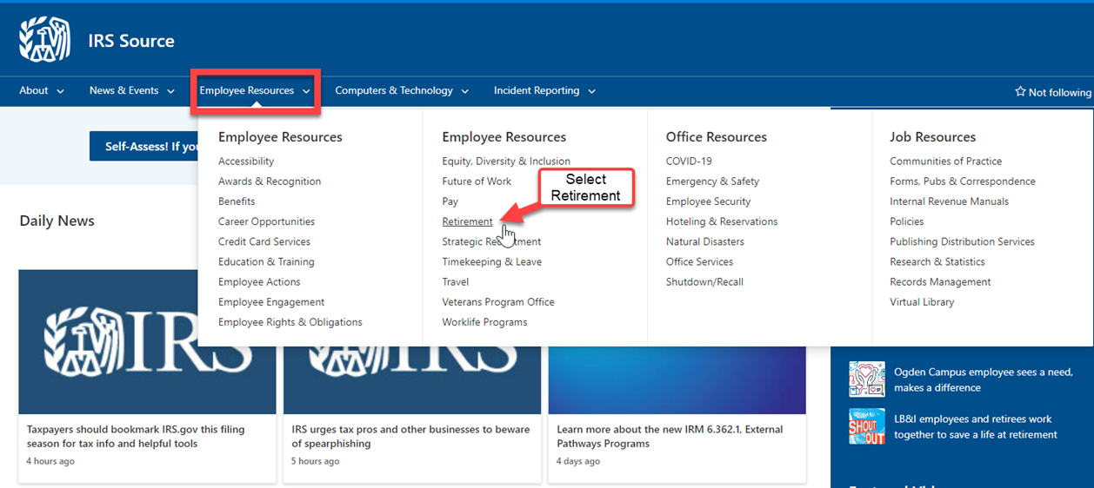
Accessing GRB Platform from work 1
Your GRB account will be accessible after you receive your first salary check. You must use your work computer to establish your GRB account the first time, then you will be able to access your account from your home devices.
From the IRS Source home page select Employee Resources, then Retirement.
Notes:
From an IRS computer, you can access the GRB Platform through IRS Source, under the Employee Resources tab.

Slide 52
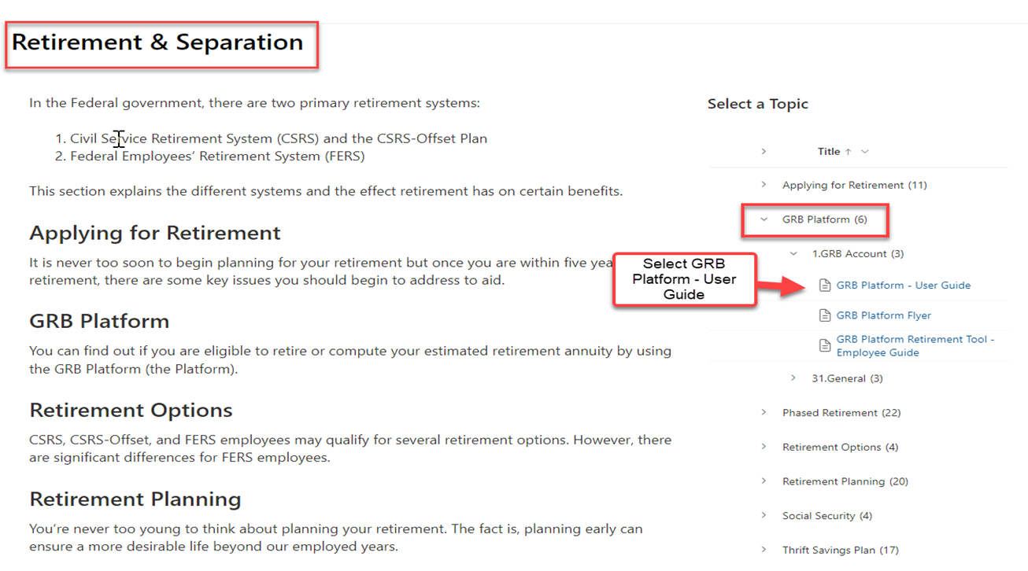
Accessing GRB Platform from Work 2
Select GRB Platform from the list of options
Notes:
Select GRB Platform, then User Guide on the right-hand column.

Slide 53
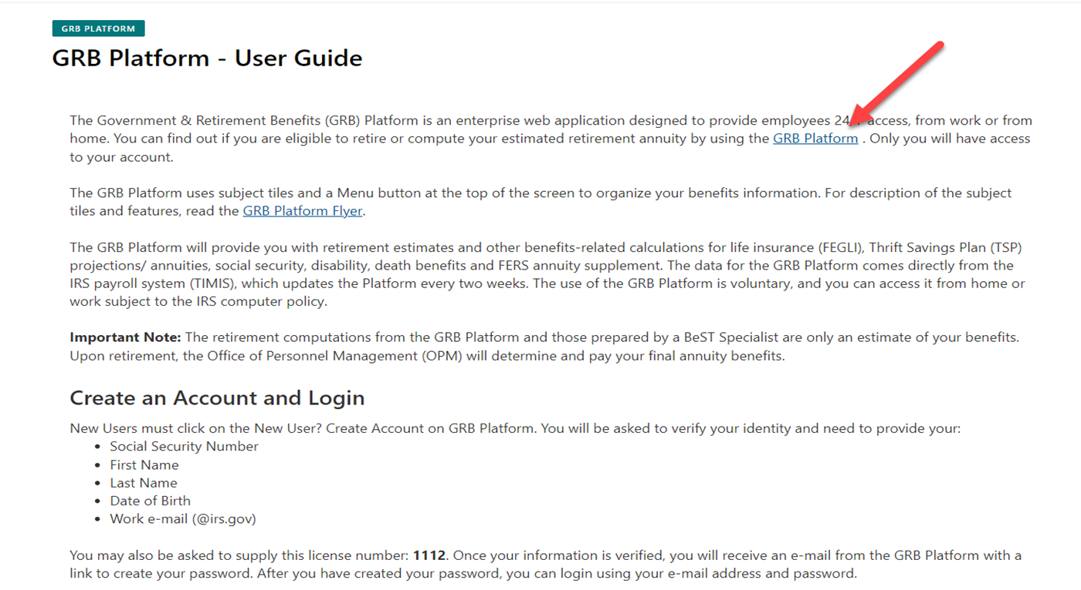
Accessing GRB Platform from Work 3
Select the GRB Platform link listed in the Platform- User Guide
Notes:
From the GRB link in the center of the page, it will carry you directly to the registration/login page.

Slide 54
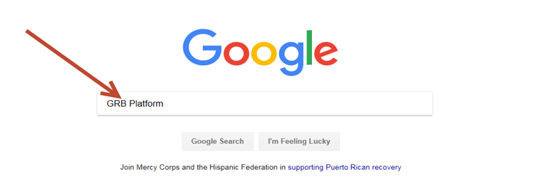
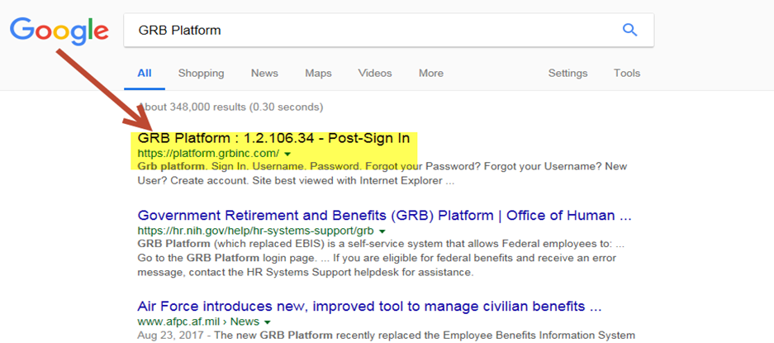
Narrowing Topic Choices 2
Input “GRB Platform in your search engine
Select GRB Platform:1.2.106.34 – Post-Sign In from the list of options
Notes:
The GRB Platform can also be located using Google. You input GRB Platform in the search and press enter. You may have to put in the license number for IRS if you access the GRB Platform this way.

Slide 55
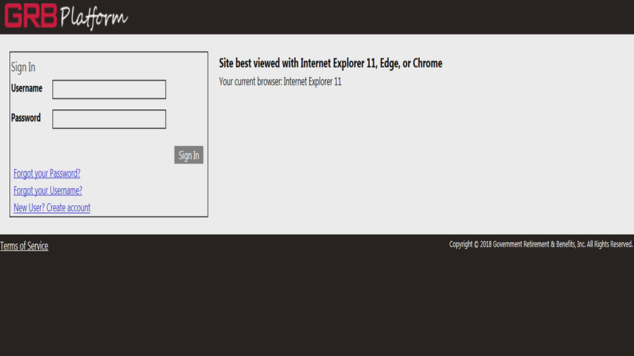
GRB Platform Login Page
Click on the New User? Create account link. You will be asked to verify your identity. You will need your:
Social Security Number
First Name
Last Name
Date of Birth
Work Email (@irs.gov)
You may also be asked to supply a license number. IRS’s license number is 1112
Notes:
When using the GRB platform for the first time, you need to register using the New User? Create account link. As stated earlier, you will need to have your IRS email to register.

Slide 56
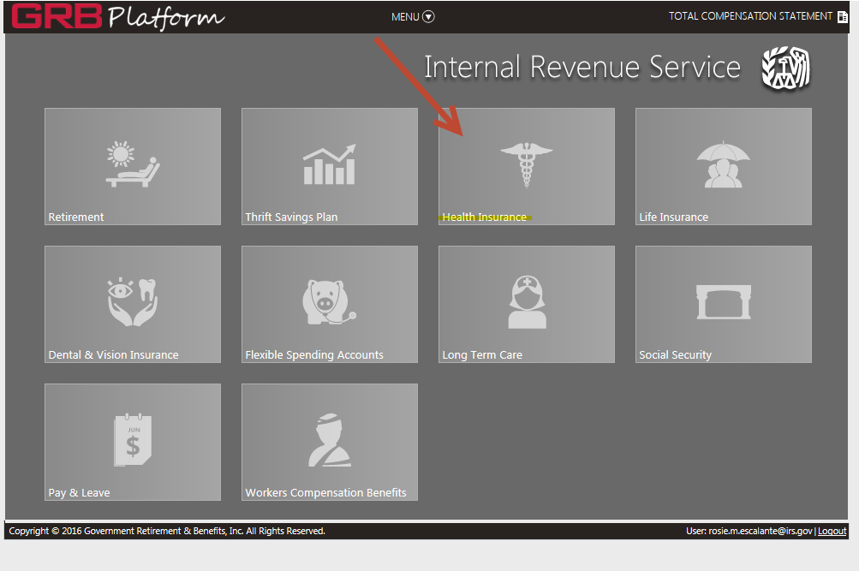
Landing Page
After logging into the GRB Platform you initially arrive at the “Landing Page”, here you will see several tiles with each tile representing a specific federal benefit program
To access information about a federal benefit program simply click the tile and it will expand to fill the window
Notes:
Once you are logged into the GRB Platform, you will see your options on the landing page. You will be able to select the individual tile for the applicable information.

Slide 57

Additional Features
To access the additional features in the GRB Platform, just click on the drop-down menu at the top of GRB and the menu window will appear
Notes:
You can also submit requests for retirement through the GRB Platform using the menu option.

Slide 58
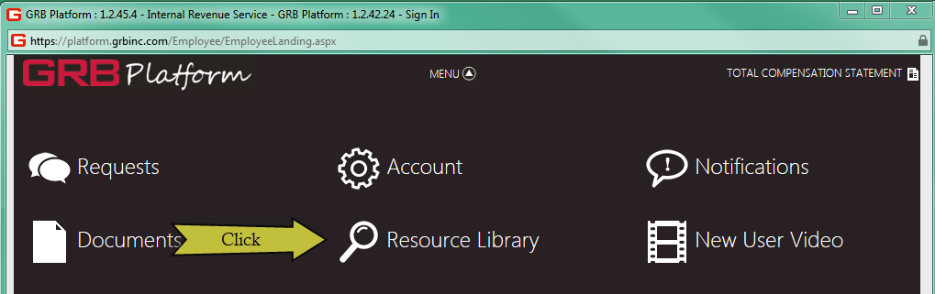
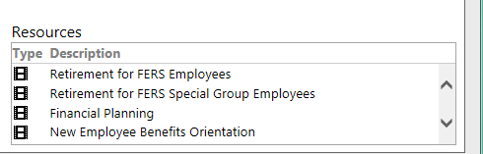
Videos, Documents, Forms, Links
To view any videos, documents, forms or external links in the GRB Platform you can go to the “Resource Library” on the Menu window
The GRB Platform provides information (e-seminar) videos such as:
Retirement for FERS or CSRS Employees
Retirement for Special Group Employees (Law Enforcement)
FEDVIP (Dental & Vision)
Life Insurance
Health Insurance
Medicare
Long Term Care Insurance
Flexible Spending Accounts
TSP
Social Security
Financial Planning
New Employee Benefits Orientation
or the “Resources” area on the benefit tiles
Notes:
There are several informational videos available, including a supplemental New Hire Orientation, located in the Resources portion of the GRB Platform.

Slide 59
State Tax Withholding
State Tax is withheld based on an employee’s duty station. Not an employee’s resident state. However, some states may have reciprocal agreements with nearby states, which allow employees to waive the duty station withholding and withhold based on their state of residence.
To change your state tax withholding from one state to another, open an IRS Service Central request.
-In the search bar type “state taxes,” select the “State Tax Waiver” option.
-You will be asked, “Do you need to waive the state taxes you are currently paying to?” select “yes,” from the dropdown menu.
-Review the document link to see if your state has a reciprocal agreement.
-If your state has a reciprocal agreement, select “yes,” from the dropdown menu, complete the questionnaire and submit your ticket.
-If your state does not have a reciprocal agreement, select “no,” from the dropdown menu and provide detailed information regarding your request.
An agent will contact you with further information to assist you
Notes:
If you live in an area with state tax withholding, the withholding rate is based on your duty location, not your resident state. Some states have reciprocal agreements with nearby states which allows employees to waive the duty station withholding and have their state of residence tax withheld.
To change your state tax withholding from one state to another, open an IRS Service Central request.
-In the search bar type “state taxes,” select the “State Tax Waiver” option.
-You will be asked, “Do you need to waive the state taxes you are currently paying to?” select “yes,” from the dropdown menu.
-Review the document link to see if your state has a reciprocal agreement.
-If your state has a reciprocal agreement, select “yes,” from the dropdown menu, complete the questionnaire and submit your ticket.
-If your state does not have a reciprocal agreement, select “no,” from the dropdown menu and provide detailed information regarding your request.
An agent will contact you with further information to assist you

Slide 60
Transferring from Another Federal Agency
If you are transferring from another federal Agency, you can submit your last Statement of Earnings and Leave for expedited service regarding the transfer of FEHB and FEGLI coverage, if your SF-75 information has not been processed.
FEHB and FEGLI
Benefits Unit
      Fax: 855-816-9805
      Email: ogden.benefits.section@irs.gov
Notes:
If you transferred from another Agency, you can submit your last Statement of Earnings and Leave for expedited service regarding the transfer of FEHB and FEGLI coverage, if your SF-75 information has not processed.
For Health and Life insurance, you can send your last Earnings and Leave Statement to the Benefits Unit
Fax: 855-816-9805
Email: ogden.benefits.section@irs.gov

Slide 61
Transferring from Another Federal Agency
If you are transferring from another federal Agency, you can submit your last Statement of Earnings and Leave for expedited service regarding the transfer of leave balances, if your SF-75 information has not been processed.
Leave Balances
Enter a service request ticket in IRS Service Central.
    Search and select “Leave Category Inquiry”
    Enter the requested information to open your ticket.
    Select “Change” in Request type field
    Type the full explanation of request to obtain prior leave balances from prior service (prior agency information and payroll POC, attachments sent, last day at agency)
    Add Attachments
    Note: regarding attachments: Only final SELs will be considered for leave transfer if the Agency has not yet received the SF-1150 from your prior agency.
    Submit
Notes:
If you are transferring from another federal Agency, you can submit your last Statement of Earnings and Leave for expedited service regarding the transfer of leave balances, if your SF-75 information has not been processed.
Leave Balances
Enter a service request ticket in IRS Service Central.
Search and select “Leave Category Inquiry”
Enter the requested information to open your ticket.
Select “Change” in Request type field
Type the full explanation of request to obtain prior leave balances from prior service (prior agency information and payroll POC, attachments sent, last day at agency)
Add Attachments
Note: regarding attachments: Only final SELs will be considered for leave transfer if the Agency has not yet received the SF-1150 from your prior agency.
Submit

Slide 62
Prior Service
Prior Active-Duty Military Service: Go to www.opm.gov and fill out the form RI-20-97.
  https://www.opm.gov/forms/pdf_fill/ri20-97.pdf
Prior Federal Civilian Service – If you have prior federal service but are NOT a transfer, please allow up to 120 days for your records to be updated (SCD/Leave Category).
Notes:
Please allow up to 120 business days for prior service information to be updated in the payroll systems. Prior active-duty military service needs to have the RI-20-97 completed and submitted as well. You can obtain this form from the OPM website.

Slide 63
Military Deposit Process
To start the process of paying your military deposit, you must first:
Request your Estimated Earnings During Military Service by completing Form RI 20-97 and send along with a copy of your DD214(s) directly to your applicable Branch of Service
When your estimate is received, access the GRB Platform upload the information and request a Military work up. You will then get your deposit amount, and comparative estimates to determine whether it is worth it to pay the deposit
Interest on the deposit amount begins to accrue two years from the date you are covered by FERS, so it is financially prudent to pay it at the beginning of your career rather than at the end
Please note this entire process may take several months, so please be sure to do this well in advance of retirement since the deposit MUST be made in full for Post 56 Military Service before credit can be given for SCD-Retirement and Annuity
(For addresses to your applicable Branch of Service contact ERC at 1-866-743-5748, Option 1)
Notes:
To make a military deposit, you must first request your estimated earnings, for your military service, from your branch of service. You can contact the Customer Service Line at ERC for the address of the applicable branch of service. Once you receive this information from the Military, you will submit the information through the GRB Platform by uploading the form and requesting a military workup. When the workup is complete, you will receive the deposit amount, along with comparative estimates to determine if making the deposit is worthwhile for you or not. Interest on the deposit amount begins to accrue 2 years from the date you are covered by FERS, so paying this at the beginning rather than at the end of your career is financially prudent. This process can take several months, so be sure to do this well in advance of retirement since the deposit MUST be made in full for Post 56 Military Service to be credited for Service Computation Date-Retirement and annuity purposes.

Slide 64
How Can You Reach Us?
For Assistance call:
1-866-743-5748
1-800-877-8339 Federal Relay Service
Call Center Hours of Operation
Gate | Monday | Tuesday | Wednesday | Thursday | Friday
Payroll & Benefits Gate | 8:00a – 6:00p (ET) | 8:00a – 6:00p (ET) | 8:00a – 6:00p (ET) | 8:00a – 6:00p (ET) | CLOSED
Timekeeping / SETR Gate | 8:00a – 6:00p (ET) | CLOSED | CLOSED | 8:00a – 6:00p (ET) | 8:00a – 6:00p (ET)
On-line at:
IRS Service Central
Employee Center Pro Homepage - Employee Center (irs.gov)
Notes:
You can reach the Customer Assistance Line at the Employee Resource Center by dialing 866-743-5748 option 1, then option 3 for Payroll.
Our hours of operation are Monday, Tuesday, Wednesday, and Thursday 8a-6p EST, 7a-5p CST, 6a-4p MST, 5a-3p PST.
Our phone line is unavailable on Fridays to address outstanding IR Works Tickets and other core work..
Memphis Payroll can be reached Monday, Thursday, and Friday, 8a-6p EST, 7a-5p CST, 6a-4p MST, 5a-3p PST.
Their phones are unavailable the 2nd Monday 1p-6p EST, 12p-5p CST, 11a-4p MST, 10a-3p PST, and all day Tuesday and Wednesday.

Slide 65
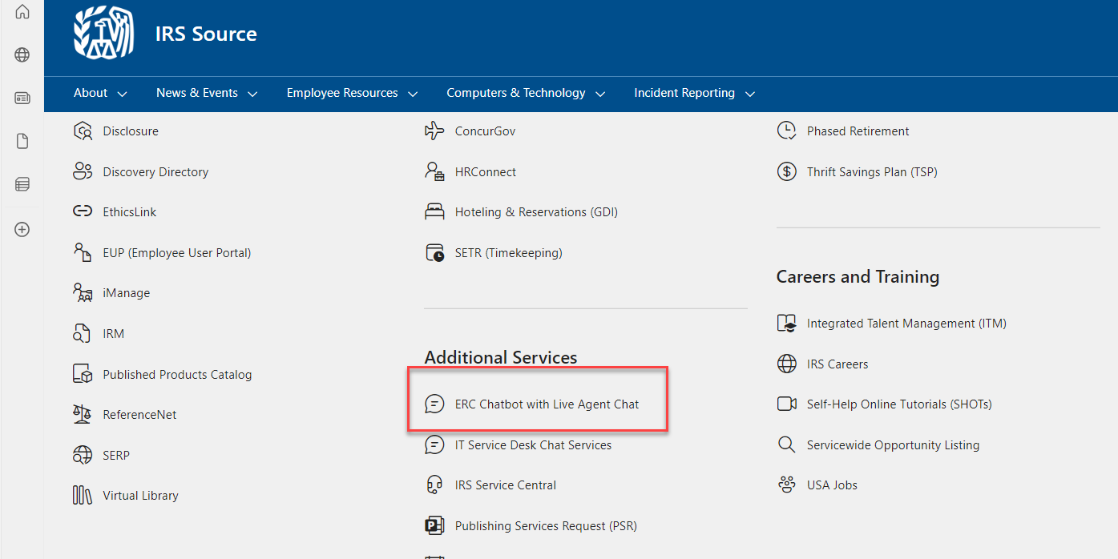
How Can you Reach Us?
Notes:
Another helpful link is the ERC Chatbot with Live Agent Chat. This can provide faster service than contacting the ERC by phone.
-Scroll down to additional services and click the ERC Chatbot with Live Agent Chat

Slide 66
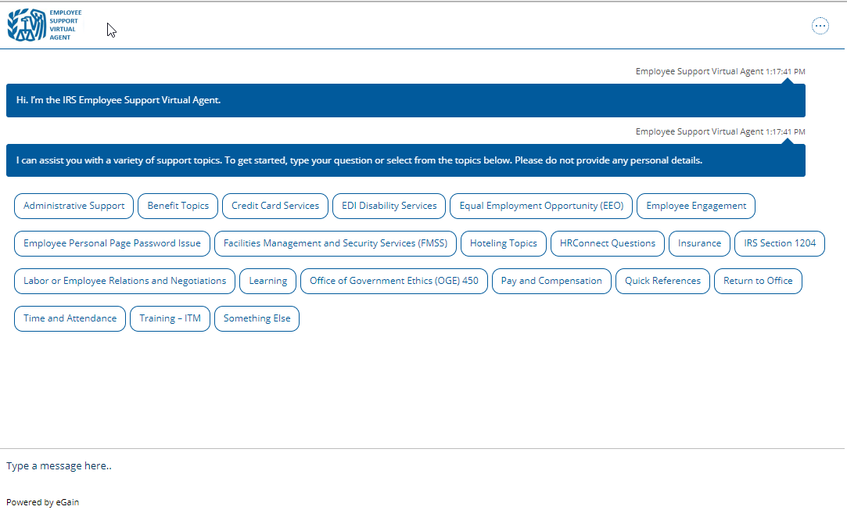
ERC Chatbot with Live Agent Chat
Notes:
A pop-up box will appear with a variety of topics you can select from, or you can simply type your message in the chat box.

Slide 67
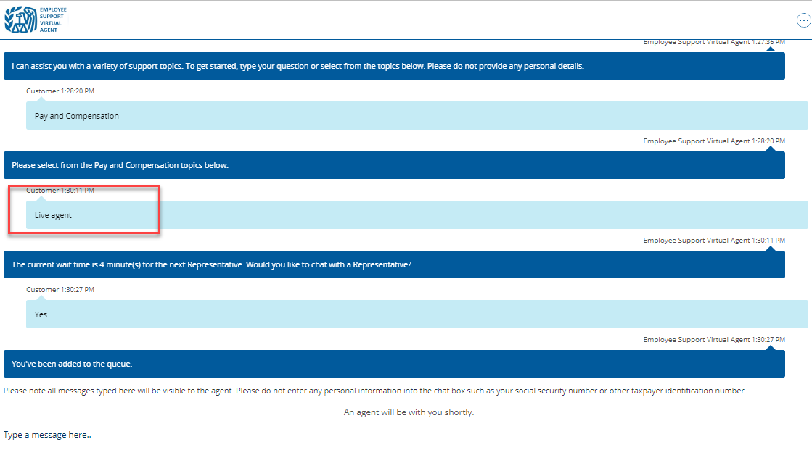
ERC Chatbot with Live Agent Chat
Notes:
If you are not finding the answer you need simply type in “Live agent” to be entered into the que.

Slide 68
Resources 2
GRB Platform - https://platform.grbinc.com
Employee Resource Center (ERC) -1-866-743-5748, Option 1
    Office of Personnel Management (OPM) - www.opm.gov
    Thrift Savings Plan – www.tsp.gov
    Social Security – www.ssa.gov
    Flexible Spending Account (FSA) – www.fsafeds.com
    Dental and Vision via the Federal Employees Dental and Vision Insurance Program (FEDVIP) - www.benefeds.com
Notes:
Additional resources we discussed today are listed here along with the link to access them.

Slide 69
Welcome Aboard
Notes:
Again, Welcome to the Internal Revenue Service. We know this was a lot of information in a short period of time, so please write down any questions and we will answer them during the scheduled Q&A session.

